Slide 1
Simulation & Modeling
Amaar (20SW015) Aashir Ali (20SW023) Mahmood Rasheed (20SW047)

Slide 2
Problem Statement
Apply the Kolmogorov-Smirnov test on the generated random numbers (with X0 = 3, a = 5, c = 3, and m = 16) to check that the numbers following the uniformity property and null hypothesis can be accepted or rejected with α=0.05. Use the first ten random numbers and Dα =0.41.

Slide 3
Step1: Generate 10 Random Numbers
Using the Linear Congruential Generator (LCG): Given: X0​=3 a=5 c=3 m=16 Formula:
Xi+1​=(aXi​+c) mod m

Slide 4
R1:
X0+1 = (aX0 + c) mod m
X1 = ((5)(3) + (3)) mod 16 X1 = 18 mod 16 X1 = 2
R1 = X1/m
R1 = 2/16 R1 = 0.125
R2:
X1+1 = (aX1 + c) mod m
X2 = ((5)(2) + (3)) mod 16 X2 = 13 mod 16 X2 = 13
R2 = X2/m
R2 = 13/16 R2 = 0.8125
R3:
X2+1 = (aX2 + c) mod m
X3 = ((5)(13) + (3)) mod 16 X3 = 68 mod 16 X3 = 4
R3 = X3/m
R3 = 4/16 R3 = 0.25
R4:
X3+1 = (aX3 + c) mod m
X4 = ((5)(4) + (3)) mod 16 X4 = 23 mod 16 X4 = 7
R4 = X4/m
R4 = 7/16 R4 = 0.4375
R5:
X4+1 = (aX4 + c) mod m
X5 = ((5)(7) + (3)) mod 16 X5 = 38 mod 16 X5 = 6
R5 = X5/m
R5 = 6/16 R5 = 0.375
R6:
X5+1 = (aX5 + c) mod m
X6 = ((5)(6) + (3)) mod 16 X6 = 33 mod 16 X6 = 1
R6 = X6/m
R6 = 1/16 R6 = 0.0625

Slide 5
R7:
X6+1 = (aX6 + c) mod m
X7 = ((5)(1) + (3)) mod 16 X7 = 8 mod 16 X7 = 8
R7 = X7/m
R7 = 8/16 R7 = 0.5
R8:
X7+1 = (aX7 + c) mod m
X8 = ((5)(8) + (3)) mod 16 X8 = 43 mod 16 X8 = 11
R8 = X8/m
R8 = 11/16 R8 = 0.6875
R9:
X8+1 = (aX8 + c) mod m
X9 = ((5)(11) + (3)) mod 16 X9 = 58 mod 16 X9 = 10
R9 = X9/m
R9 = 10/16 R9 = 0.625
R10:
X9+1 = (aX9 + c) mod m
X10 = ((5)(10) + (3)) mod 16 X10 = 53 mod 16 X10 = 5
R10 = X10/m
R10 = 5/16 R10 = 0.3125

Slide 6
Step2:Sort All Generated Random Numbers In Ascending Order
Before Sorting: {0.125, 0.8125, 0.25, 0.4375, 0.375, 0.0625, 0.5, 0.6875, 0.625, 0.3125}
After Sorting: {0.0625, 0.125, 0.25, 0.3125, 0.375, 0.4375, 0.5, 0.625, 0.6875, 0.8125}

Slide 7
Step3: Find the value of D⁻ and D⁺
_{R(i)} | 0.0625 | 0.125 | 0.25 | 0.3125 | 0.375 | 0.4375 | 0.5 | 0.625 | 0.6875 | 0.8125
_{i/N} | 0.1 | 0.2 | 0.3 | 0.4 | 0.5 | 0.6 | 0.7 | 0.8 | 0.9 | 1.0
_{i/N-R(i)} | 0.0375 | 0.075 | 0.05 | 0.0875 | 0.125 | 0.1625 | 0.2 | 0.175 | 0.2125 | 0.1875
_{R(i) – (i-1)/N} | 0.0625 | 0.025 | 0.05 | 0.0125 | - | - | - | - | - | -
D+ = max(i/N - R(i)) = 0.275 D⁻ = max(R(i) – (i-1)/N) = 0.0625
D = max(D+, D-) = 0.275 Since D=0.275 is less than Dα=0.41, so the null hypothesis is not rejected.

Slide 8
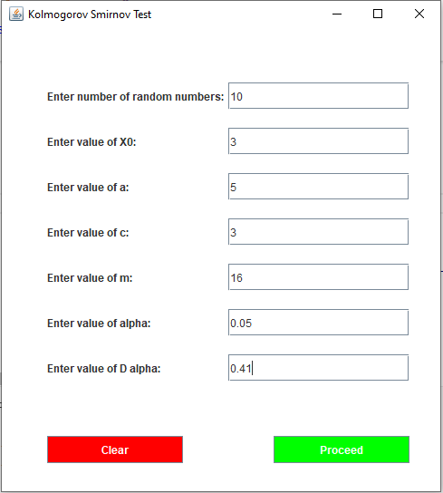

Slide 9
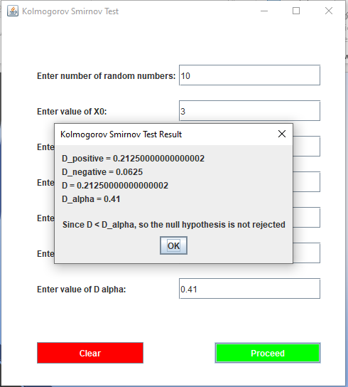

Slide 10
THANK YOU

